Slide 1
Mantid Developer meeting
Release 2.5
9th May 2013

Slide 2
Agenda
Feedback on development processes (Nick + All)
How to Test Tickets (Russell)
Git refresher (Martyn)
Maintenance fortnight (Nick + All for suggestions)
Design overview of script repository (Gesner / Nick)
Wikimaker (Owen)
Offline Help (Peter)
PV changes for VATES (Michael)
Instrument view – how to add guides etc (Roman)
SetSampleMaterial + absorption corrections (Peter)
Sassena (Jose)

Slide 3
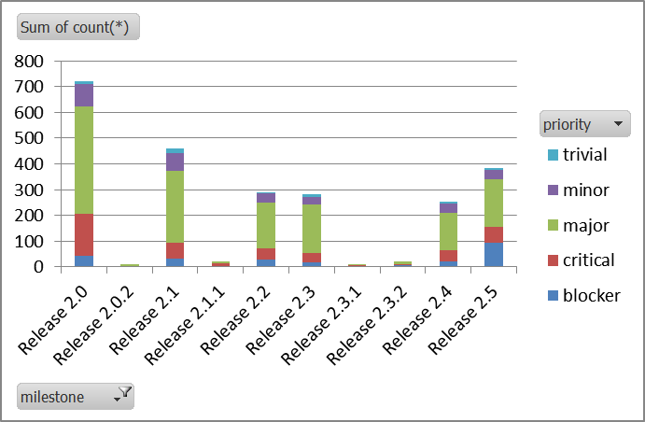
Release Summary
13 weeks
2 weeks maintenance
9 weeks feature development
1 week testing and release
385 Fixed Tickets
PV 3.98 Integration
Workflow Changes
Development
Testing
Release
5 Months

Slide 4


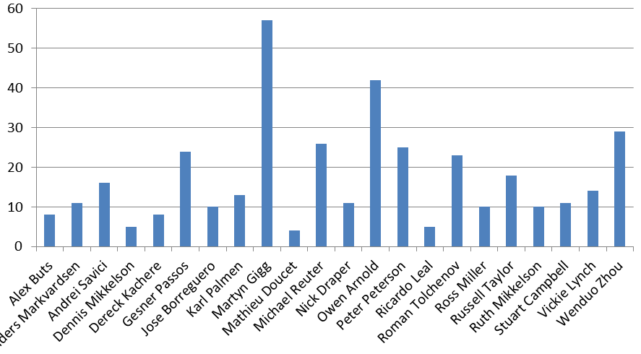
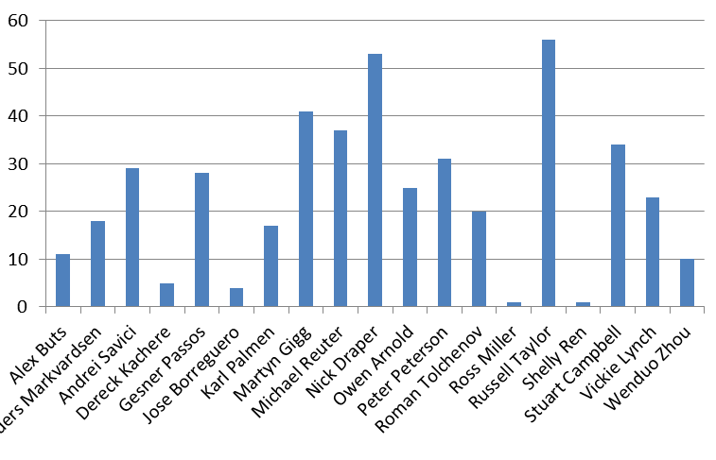
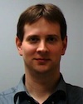
Release Summary
Top Developer
Top Tester
Honourable Mention

Slide 5

What went well? What could have gone better?

Slide 6
How to Test Tickets
http://www.mantidproject.org/Individual_Ticket_Testing
Git Refresher
http://www.mantidproject.org/Git_Workflow

Slide 7
Maintenance Fortnight
Timebox Deadline: 20th May
Directly Assigned Tickets
Some tickets will require input from others
High priority work
Retirement of Python API v1
Other ideas for maintenance work
This release
Future

